Slide 1

Over Prescribing & overdose
Christian Alsider

Slide 2

Introduction
In the past addictions and overdoses were seen as “social class” problems.
The introduction of Oxycodone changed that. The dope dealer moved from the trap house to the doctor's office. Suddenly overdoses were no longer the panda eye junkie from the after-school PSA, they are high functioning members of society who no one suspects has an addiction.
Was it the change in the prescribing habits of our providers?

Slide 3

How did we get here?
1997 Oxycodone hits market
2000
Purdue profits 1.1 billion
2007
Admits oxy addicting
2002
Time release broken
2011
New unbreakable formula
2015
Fentanyl hits TN
2017
Opiate epidemic declared
https://www.ncbi.nlm.nih.gov/pmc/articles/PMC2622774/

Slide 4
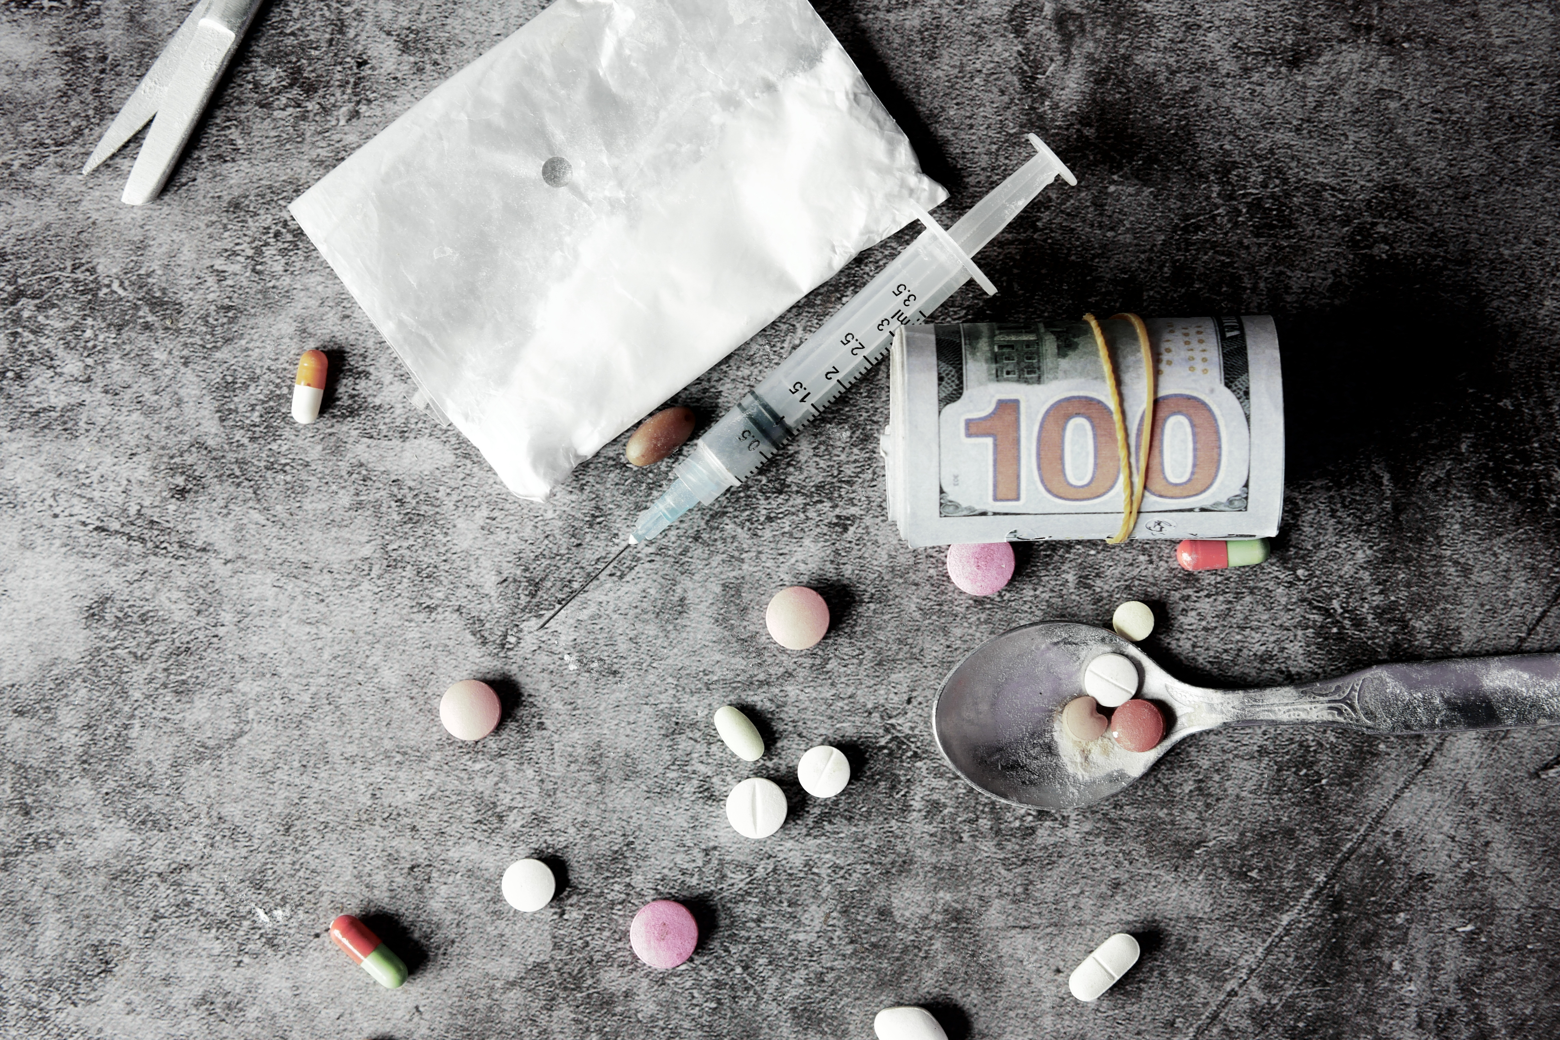
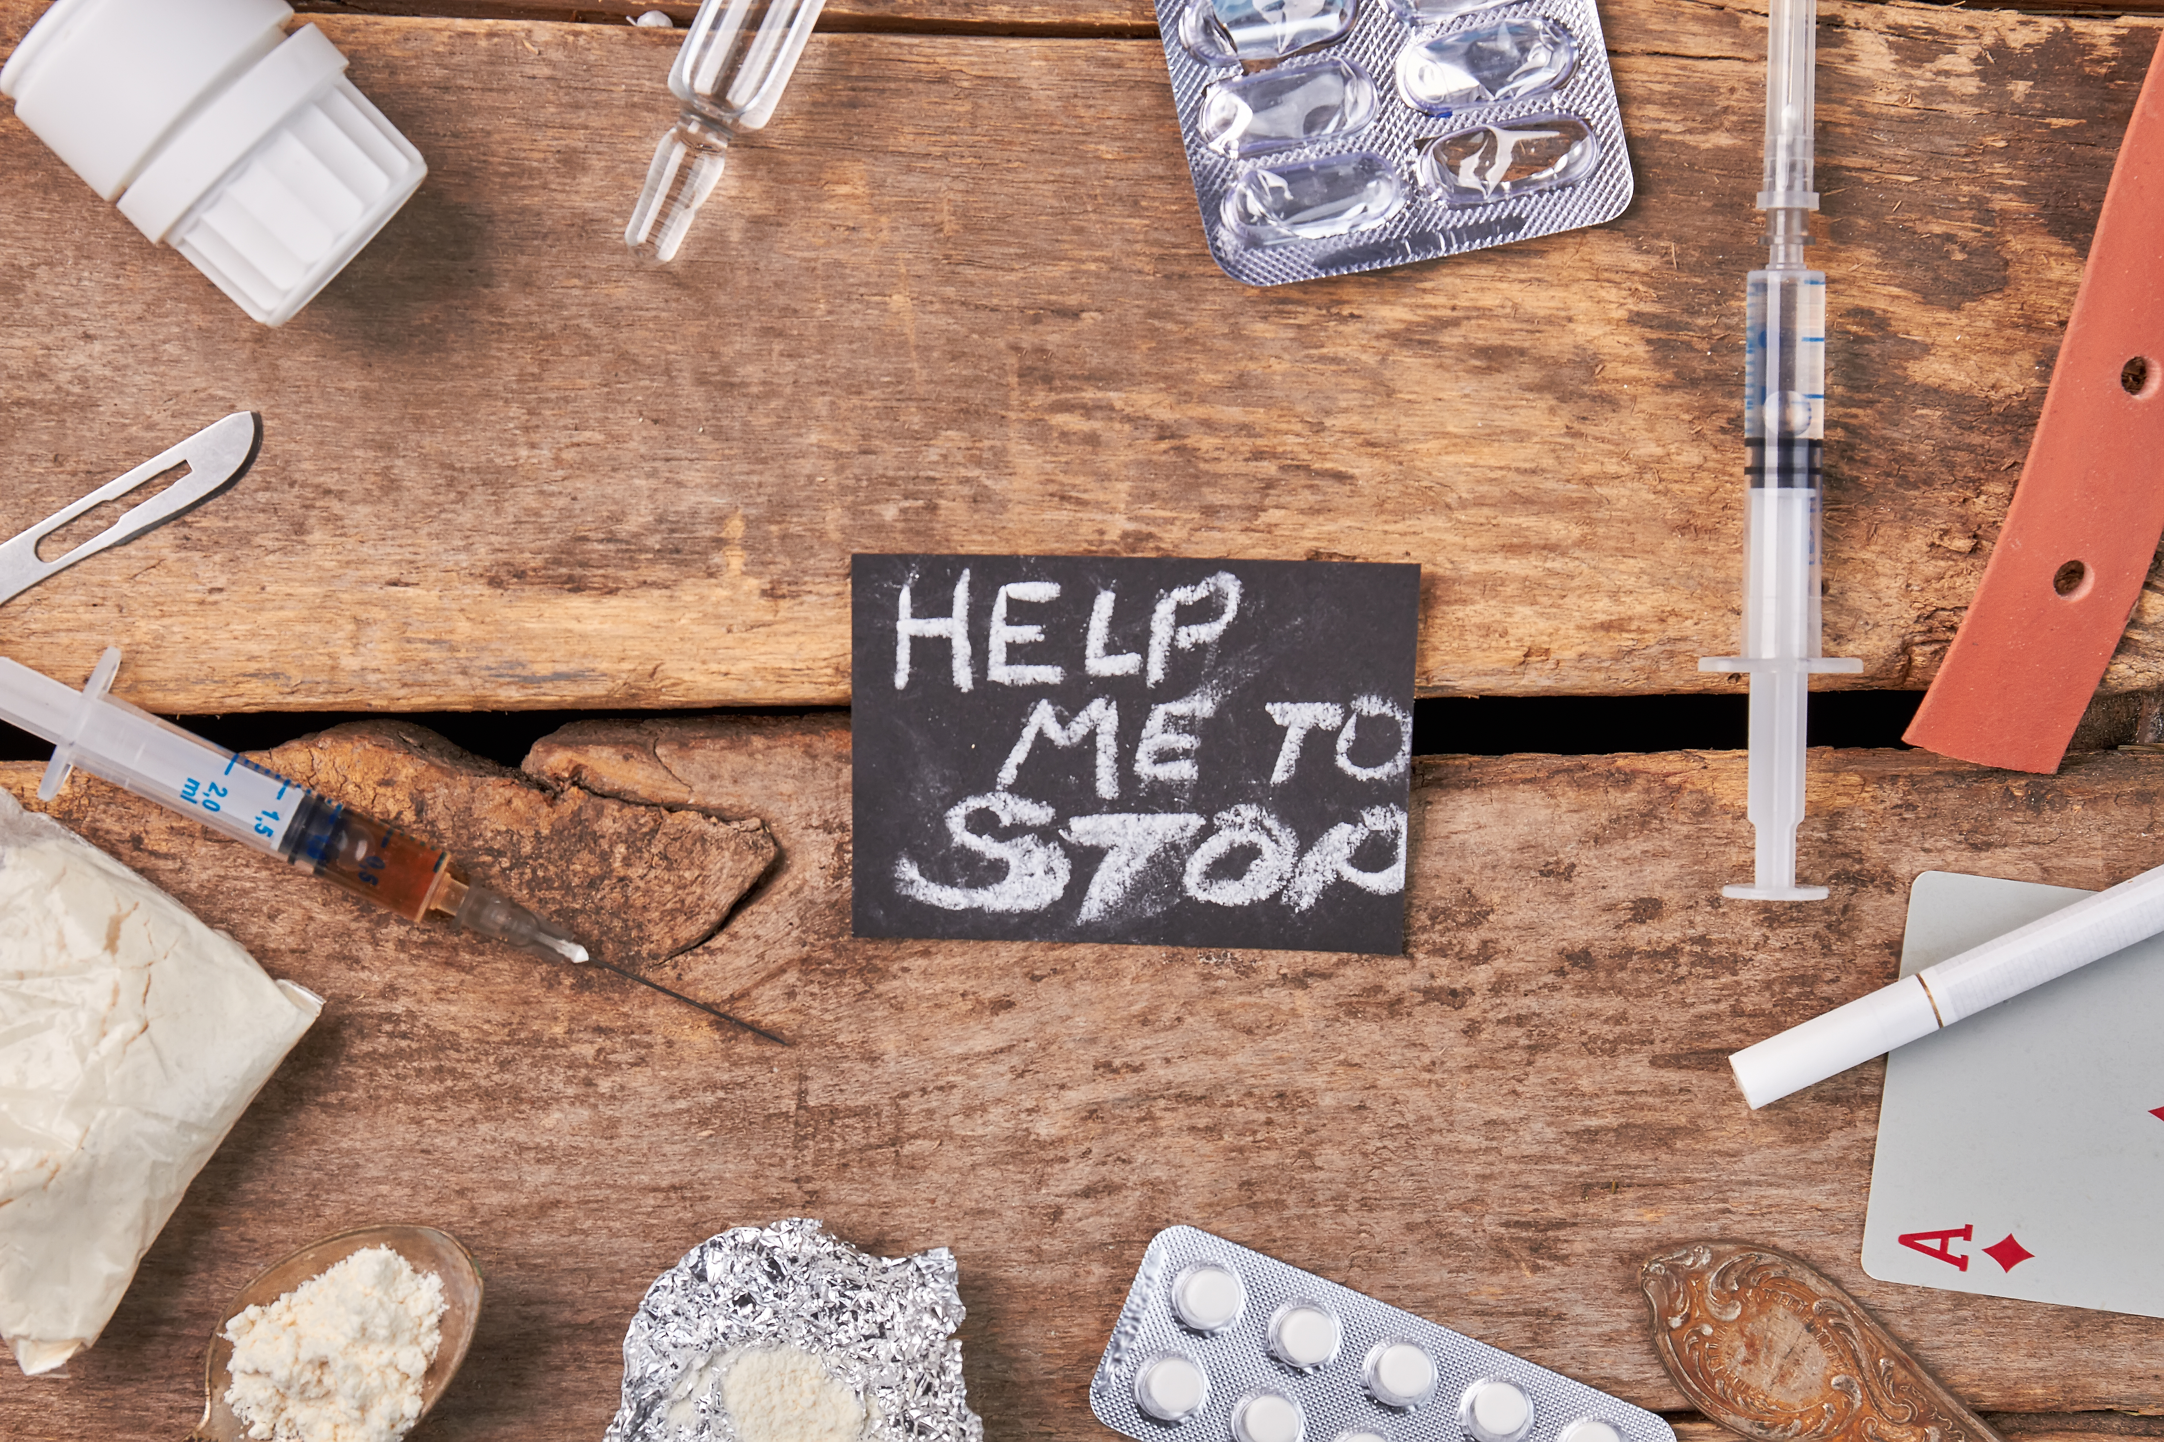
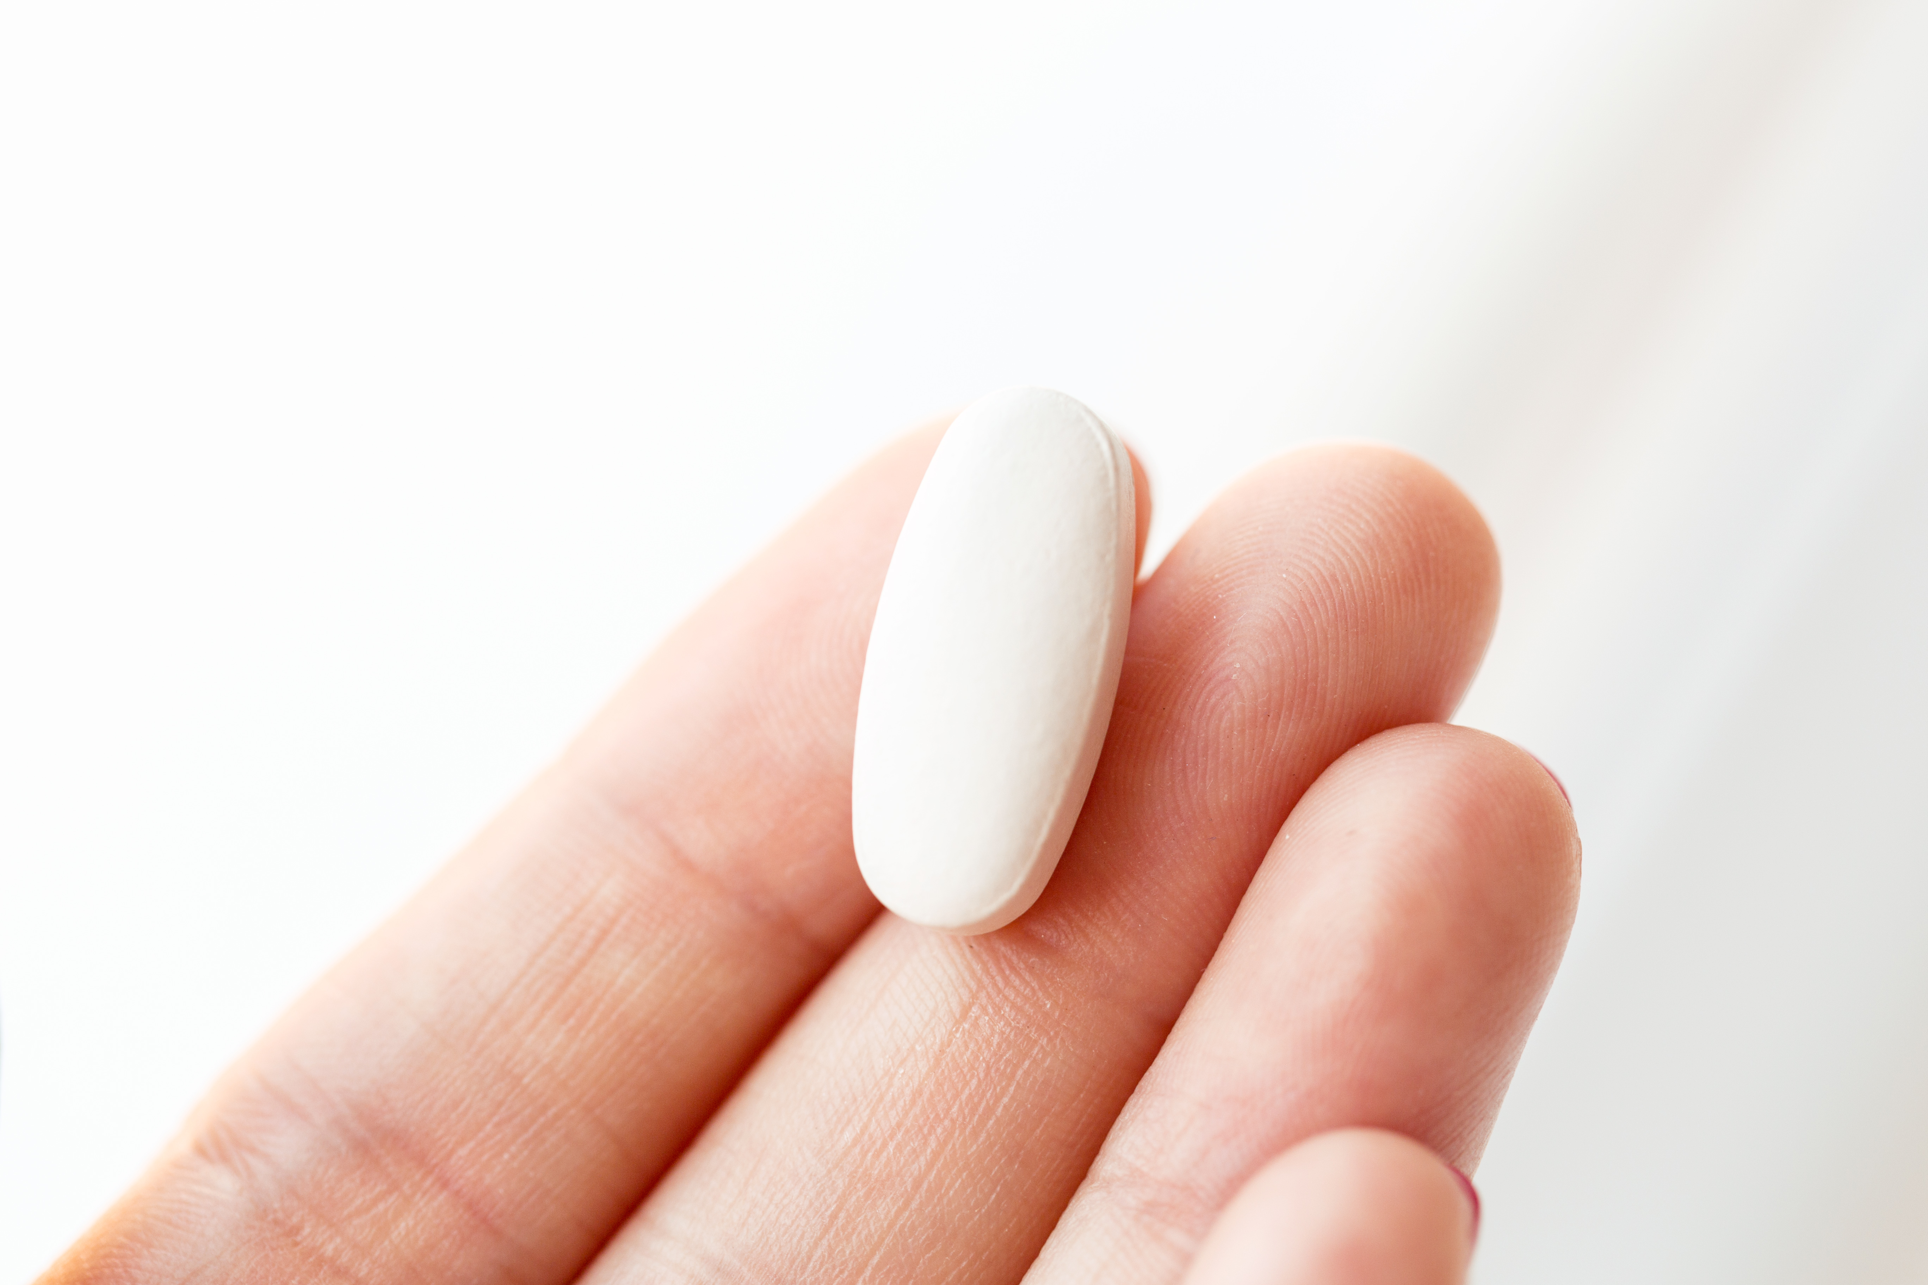
Prescribing trends

Slide 5
Opiate prescription's 2006-2020

Slide 6
Prescriptions USA vs TN

Slide 7
Top Prescribed Drugs By Year

Slide 8
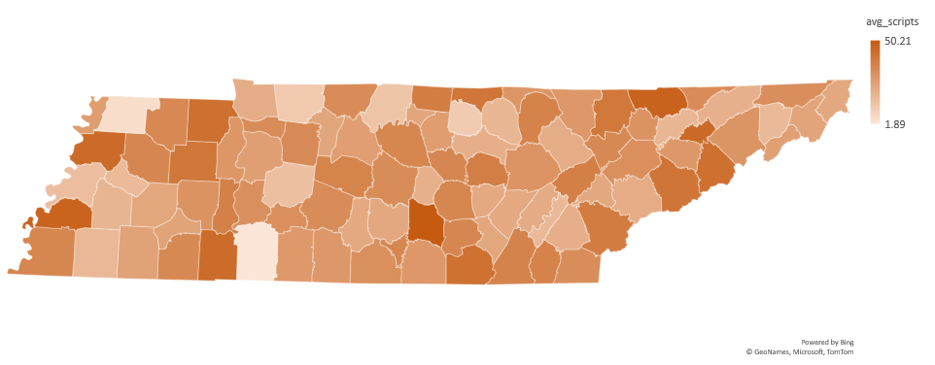
Prescriptions by county
Per 100 people

Slide 9
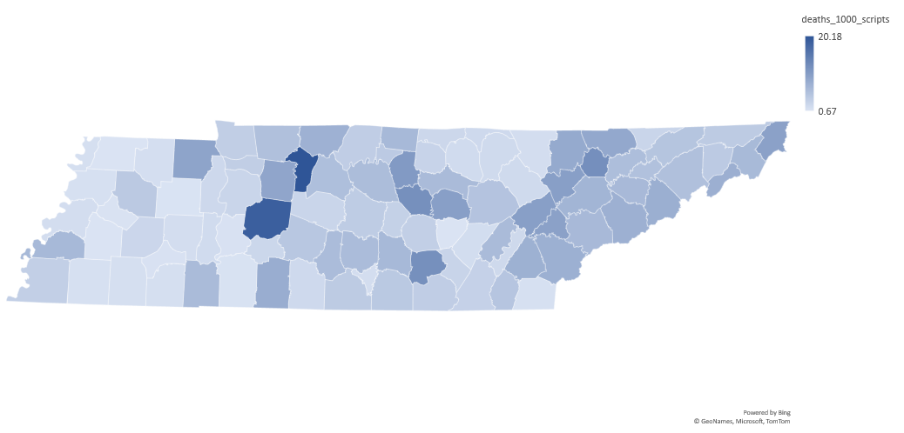
Deaths by Scripts

Slide 10
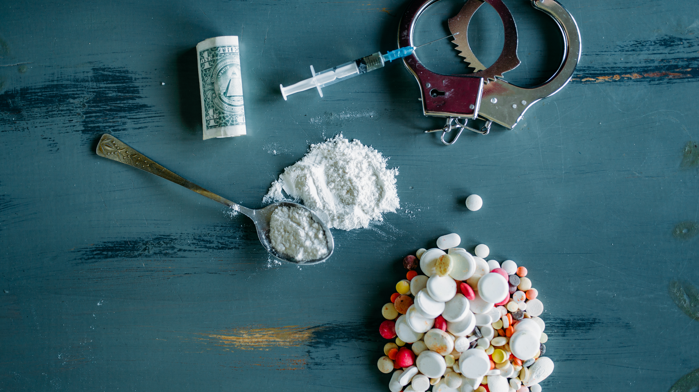
Fatal overdoses

Slide 11
Fatal overdoses 2013-2020

Slide 12
Fatal overdoses USA 1980-2020

Slide 13
Fatal OD BY Drug and Year

Slide 14
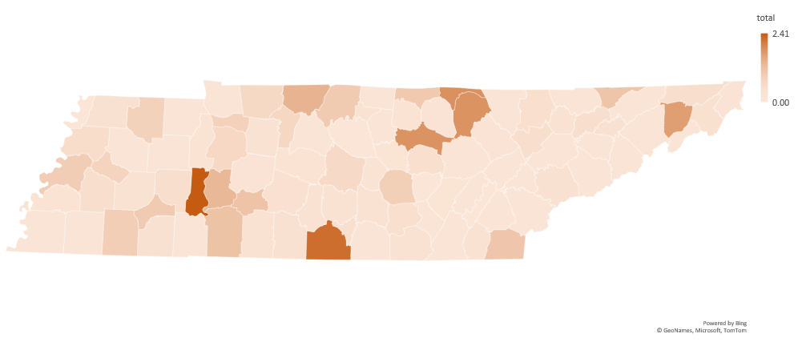
Fatal BY County
Per 100 people

Slide 15

The way to get started is to quit talking and begin doing.
Walt Disney
Non Fatal Overdoses
Fatal overdoses

Slide 16
Non-Fatal overdoses 2013-2020

Slide 17
Non-fatal OD by drug and year

Slide 18
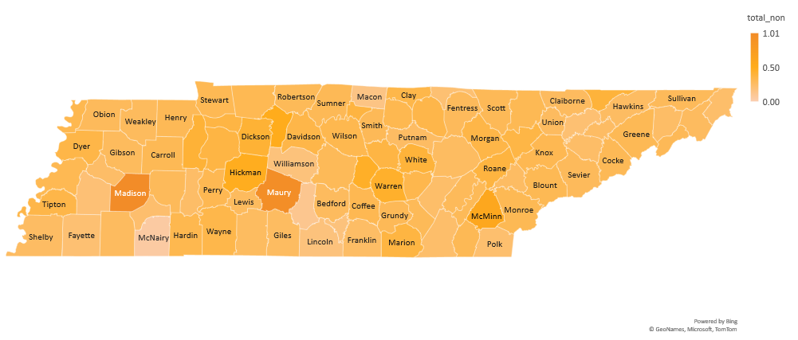
Non-fatal by county
Per 100 people

Slide 19
In Conclusion

Slide 20
Challenges
The state didn’t start tracking until 2016
US prescription data isn’t broken down by drug
All data for prescribing habits of opiates begins in 2006
Non-Fatal OD data doe not separate out fentanyl
VA doesn’t supply the state with their scripts or OD information

Slide 21
References
Data Sources
Tools used
Articles quoted
https://www.cdc.gov/
https://www.census.gov/
https://www.tn.gov/
SQL
Python
Power Point
Excel
https://www.ncbi.nlm.nih.gov/pmc/articles/PMC2622774/

Slide 22


Thank you
Christian Alsider
christianlalsider@gmail.com
www.linkedin.com/in/christianalsider

